Slide 1


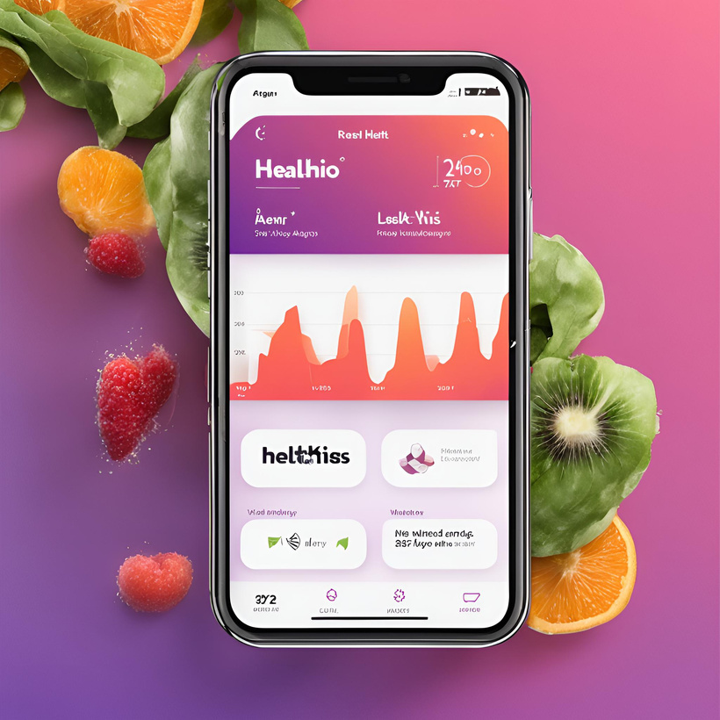
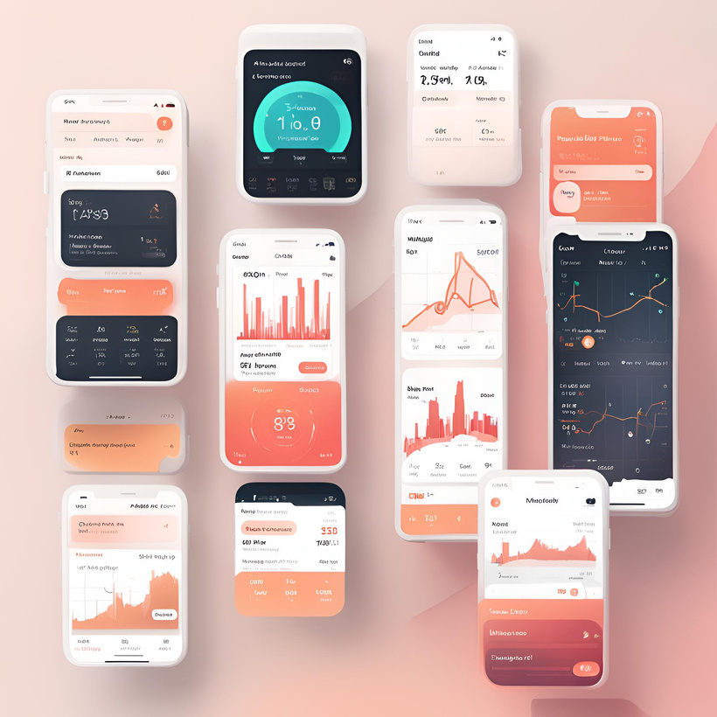
Healthio Company
Home
Service
About Us
Contact
HEALTHIO
WELLNESS, REDEFINED
WWW.HEALTHIO.COM

Slide 2



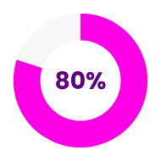
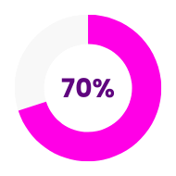
Healthio Company
Home
Service
About Us
Contact
Welcome To Helthio
Welcome to Healthio, your ultimate companion for a healthier, more vibrant life. Healthio is designed to empower you on your wellness journey, providing you with the tools and insights you need to achieve your health goals with ease. Whether you're tracking your daily activity, monitoring your nutrition, or setting personalized fitness goals, Healthio simplifies the process and keeps you motivated every step of the way.
Our intuitive interface ensures that all your health data is at your fingertips, enabling you to make informed decisions about your well-being. With real-time updates, personalized recommendations, and comprehensive progress reports, Healthio is more than just an app—it's your partner in health.
Experience the future of wellness with Healthio and take the first step towards a healthier, happier you. Join our community today and start your journey to better health with confidence.
Day 1
Day 2

Slide 3

Healthio Company
Home
Service
About Us
Contact
Healthio Advantages
01
Comprehensive Health Snapshot: The Dashboard provides an at-a-glance overview of your health metrics, including activity levels, nutrition, and progress, helping you stay informed and motivated.
02
Detailed Progress Analysis: Progress Reports offer detailed analyses of your health journey, highlighting improvements and areas that need attention, ensuring you stay on track towards your goals.
02
Real-Time Tracking: With the Activity Tracker, monitor your daily physical activities in real-time, ensuring you meet your fitness goals and stay active throughout the day.
04
Customizable Goal Setting: Set and customize your personal health and fitness goals. The app provides tailored plans and reminders to keep you motivated and focused on achieving your objectives.
03
Personalized Nutrition Insights: The Nutrition Log allows you to track your food intake and provides personalized dietary recommendations to help you maintain a balanced and healthy diet.
06
Engaging Community: Connect with a supportive community of like-minded individuals. Share your journey, exchange tips, and find motivation and encouragement from others pursuing similar health goals.

Slide 4



Healthio Company
Home
Service
About Us
Contact
Healthio’s Menu
01
Efficient Navigation: The menu offers streamlined access to essential features, ensuring users can navigate the app easily and efficiently.
02
Clear Categorization: Menu items are organized into clear categories, making it simple for users to locate and access specific functionalities without confusion.
03
Visual Hierarchy: The menu utilizes visual hierarchy to prioritize important sections, guiding users towards key features such as activity tracking, nutrition logging, and community support with ease.

Slide 5
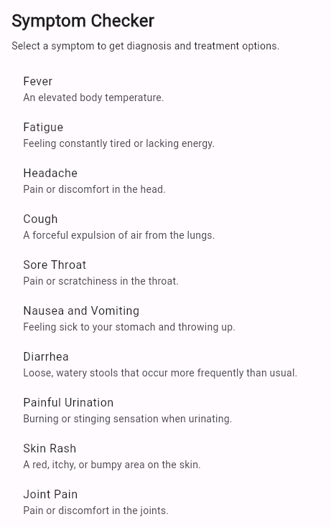
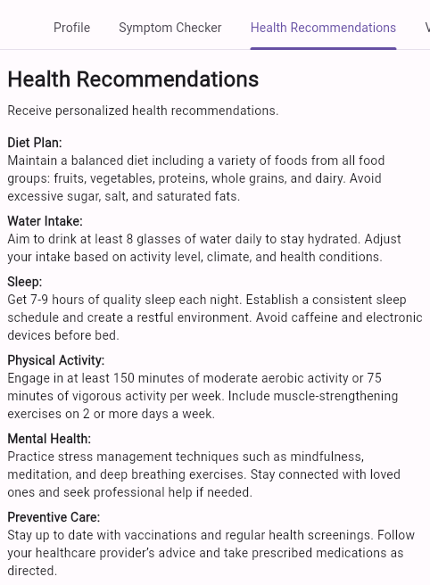


Healthio Company
Home
Service
About Us
Contact
Healthio Features
01
Instant Health Insights: The Symptom Checker allows users to input their symptoms and receive instant, data-driven insights and potential diagnoses, empowering them to make informed health decisions.
02
Personalized Health Advice: The Health Recommendations feature provides users with tailored advice and tips based on their health data and goals, ensuring personalized and actionable guidance for a healthier lifestyle.
03
Up-to-Date Immunization Records: The Vaccination Tracker keeps users' immunization records organized and up-to-date, sending timely reminders for upcoming vaccinations and boosters to maintain optimal health.
04
Comprehensive Health Library: The Educational Resources section offers a comprehensive library of articles, videos, and tutorials on various health topics, helping users expand their knowledge and stay informed about best health practices.

Slide 6

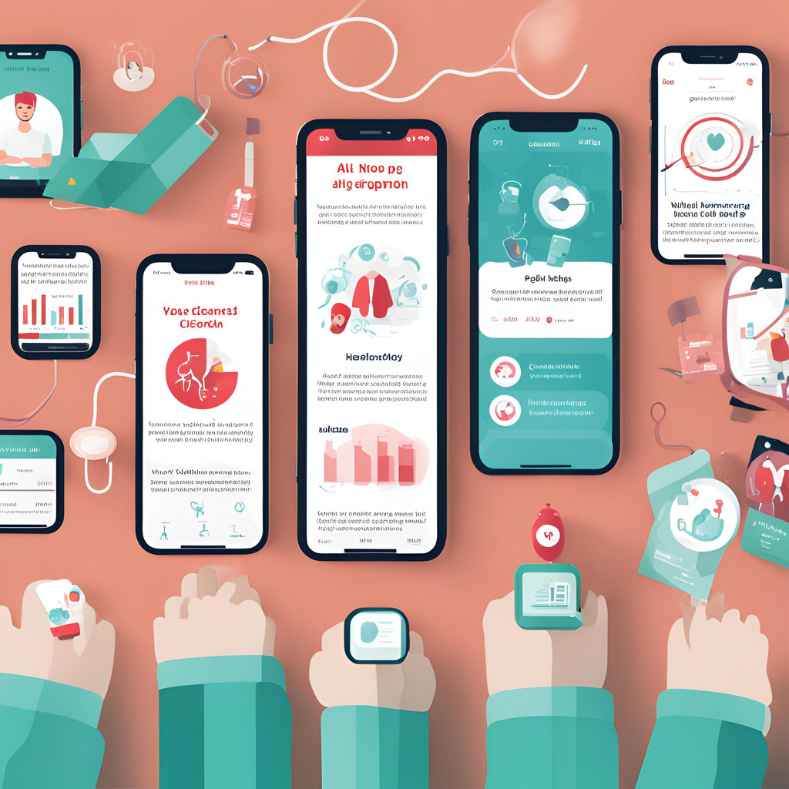
Healthio Company
Home
Service
About Us
Contact
Update!!
The Educational Resources section of our health app is a rich repository of knowledge curated to empower users with comprehensive insights into various aspects of health and wellness. With an extensive collection of articles, videos, and tutorials authored by healthcare professionals and experts, users gain access to credible information covering diverse topics such as nutrition, fitness, mental health, disease prevention, and more. Interactive learning tools, including quizzes, self-assessments, infographics, and visual aids, offer engaging ways to deepen understanding and apply newfound knowledge to daily life.
Regular updates ensure users stay abreast of the latest research findings, trends, and best practices in the ever-evolving field of healthcare. Personalized content suggestions cater to individual interests and health goals, fostering a tailored learning experience. Furthermore, the Educational Resources section fosters community engagement through discussion forums and live Q&A sessions with experts, providing users with opportunities to connect, share insights, and seek guidance on their health journeys. Overall, it serves as an invaluable resource hub, empowering users to make informed decisions and take proactive steps towards better health and well-being.

Slide 7

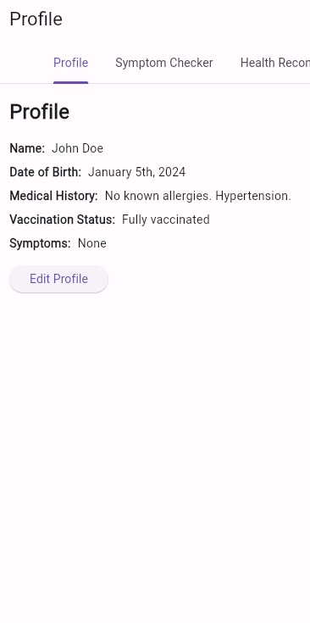

Healthio Company
Home
Service
About Us
Contact
Healthio’s
Portfolio
Access all your health-related information in one place, including activity levels, nutrition intake, sleep patterns, and medical history, for a comprehensive overview of your well-being.
01
Set personalized health goals and easily monitor your progress over time, with visual representations and automated reminders to help you stay on track.
02
Gain insights into your health trends and patterns through interactive charts and graphs, allowing for easy interpretation of your data and informed decision-making.

Slide 8




Healthio Company
Home
Service
About Us
Contact
Portfolio 01
Portfolio 03
Portfolio 05
Portfolio 02
Portfolio 04

Slide 9






Healthio Company
Home
Service
About Us
Contact
Contact Us!
+123-456-7890
www.healthio.com
healthio@gmail.com
123 Anywhere ST., Any City, ST 12345
Need assistance or have a query? Reach out to us anytime!
Have questions? We're here to help! Contact us for prompt assistance.
Get in touch with our support team for personalized assistance and quick solutions.

Slide 10



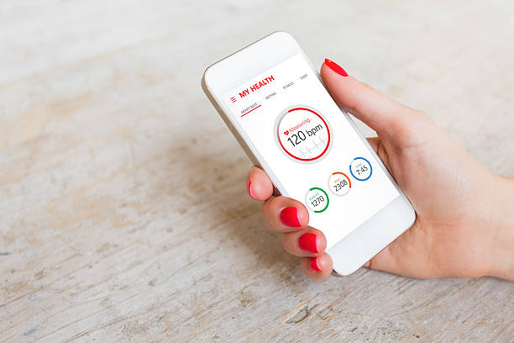


Healthio Company
Home
Service
About Us
Contact
Thank You
Thank you for choosing us! We appreciate your trust and look forward to serving you again soon.

Slide 11


Healthio Company
Home
Service
About Us
Contact
MEET
Vignesh L
Ponmurugaiya P
OUR
TEAM
Sam Santhosh J
Mohana Prasath V
"NOURISH YOUR BODY, NOURISH YOUR JOY"

